Slide 1
HL ONLY!
TOPIC B2:
PROGRAMMING
LESSON B2-12
RECURSION

Slide 2
AGENDA
Recursion
NOTE!
Have a way to take notes and a way to write code available for this lesson

Slide 3

THE WARM UP QUESTION
Y’all are gonna love this one
Write the binary search algorithm from memory (as best you can)
(yes, again)

Slide 4
THE WARM UP ANSWER
nums = [2, 5, 9, 11, 15, 19, 20, 23, 27, 29, 30, 31, 34, 36] key = 11 found = False lower = 0 upper = len(nums) mid = 0 while lower <= upper and found == False: mid = int((lower+ upper)/2) if nums[mid] == key: found = True elif nums[mid] < key: lower = mid + 1 else: upper = mid - 1 if found: print('The value was found at index', mid) else: print("The value was not found")

Slide 5
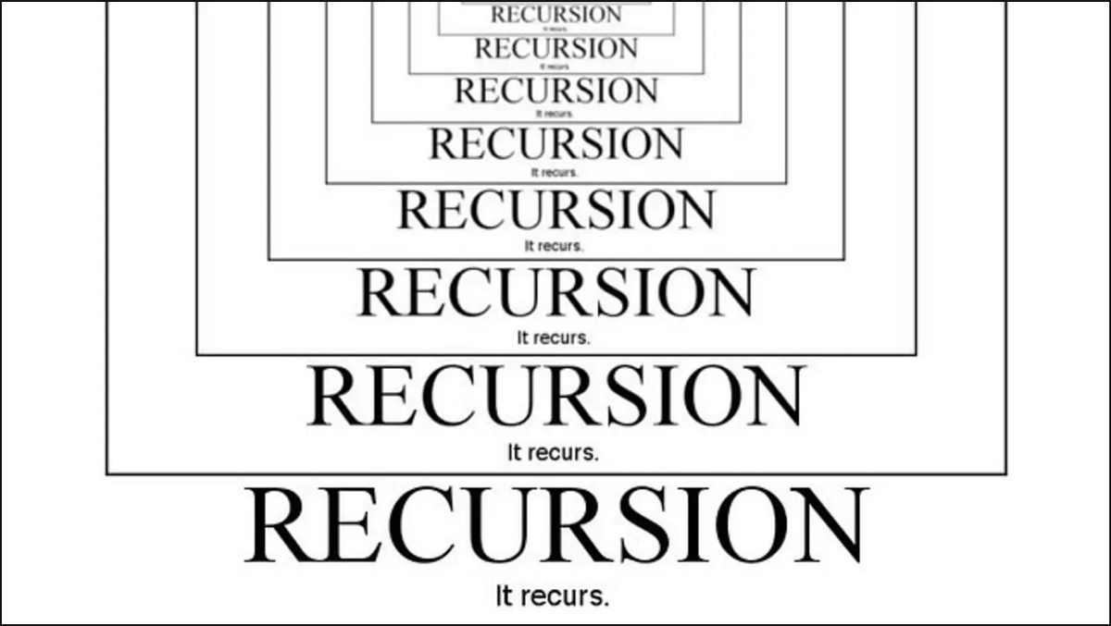
RECURSION
Recursion is a technique that involves the use of functions that call themselves
They continue doing this until a specific condition is met, and the functions exit with a solution

Slide 6

RECURSION
Recursive algorithms generally carry a few characteristics
A termination condition known as a base case (catchy!)
Without this, the algorithm would run forever
A recursive case that moves the algorithm forwards towards the base case by changing itself

Slide 7

RECURSION
Once the base case is reached, the algorithm will ‘unwind’ itself, exiting all of the functions it entered
You can think about this like Russian nesting dolls if you want

Slide 8
FACTORIAL
Previously, we’ve looked at how to implement factorial calculation using loops
You can see code to do that on the right
Pretty simple right?
n = int(input("Enter the number to factorial: ")) factorial = 1 for i in range(1, n+1): factorial *= i print(factorial)

Slide 9
FACTORIAL
And here’s the recursive implementation of factorial
We can see that it’s approximately the same length of code, but it’s just a different approach to the same problem
def factorial(n): if(n==1): return 1 else: return n * factorial(n-1) print(factorial(8))

Slide 10
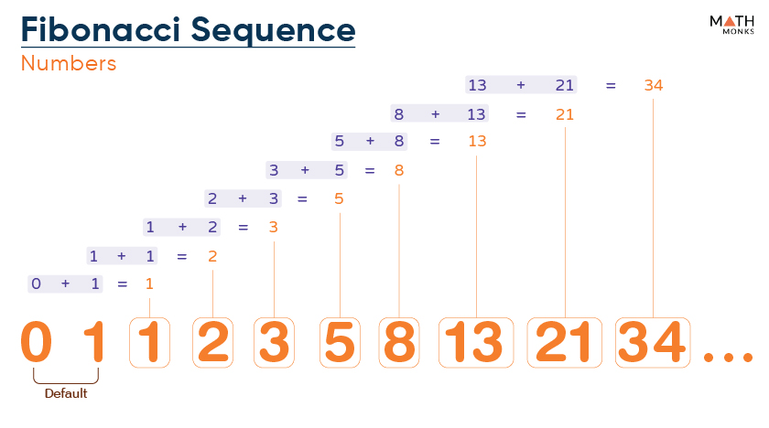
FIBONACCI
def fib(n): if n == 0: return 0 elif n == 1: return 1 else: return fib(n-1) + fib(n-2) print(fib(8))
Now let’s look at another classic recursion example: The Fibonacci sequence
A number in the Fibonacci sequence is the result of the two numbers before it added together
The base cases are that fib(0) = 0 and fib(1) = 1

Slide 11
FIBONACCI
def fib(n): if n == 0: return 0 elif n == 1: return 1 else: return fib(n-1) + fib(n-2) print(fib(8))
The fib function calls itself with n-1 and n-2 to represent the two previous numbers in the sequence

Slide 12
USES OF RECURSION
Many algorithms that could be implemented using loops (iteratively) can also be implemented using functions (recursively)
Take our linear search code on the right
nums = [5, 123, 13, 64, 89, 12] location = -1 key = 64 for i in range(0, len(nums)): if nums[i] == key: location = i print(location)

Slide 13
USES OF RECURSION
This could also be implemented using recursion
We are using very similar logic, and it takes roughly the same amount of code
def linear_search(arr, i, key): if (i == 0): return -1 elif (arr[i - 1] == key): return i - 1 return linear_search(arr, i - 1, key) nums = [5, 123, 13, 64, 89, 12] print(linear_search(nums, len(nums), 64))

Slide 14
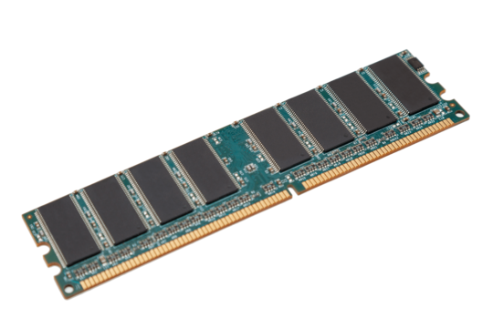
USES OF RECURSION
But, for a problem like linear search, we don’t really need to use recursion… do we?
Recursion comes with quite a bit of overhead
Each method that we call is still running when we call the next one
If the input got large enough, we’d eventually run out of space in memory for the algorithm
What would be the space complexity for this linear search algorithm implemented recursively?

Slide 15
USES OF RECURSION
Generally, it is best to use recursion only for problems where the code is much simpler, or the recursion mimics the way that we think about the problem
For example, when I think of factorial or fibonacci sequences, I think of them recursively in my own mind
For linear search, I think of the algorithm sequentially
For your purposes in this class, either is generally valid
There are some problems for which recursion is the much easier way to solve them that we will discuss much later in the year

Slide 16
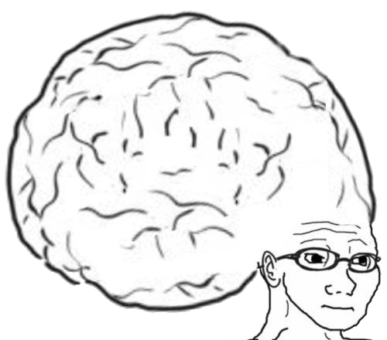
VOCAB TO REMEMBER
Sorting Algorithm
Bubble Sort
Selection Sort

Slide 17
LABBY LAB (JUST ONE)
One of the most famous recursion problems is the Towers of Hanoi
Look up ‘towers of Hanoi’ on Google and click the first link (probably the Mathisfun link)
Try to solve the towers of Hanoi at sizes of at least 5
Once you’re done, let me know why you think this is a recursion problem

